Slide 1
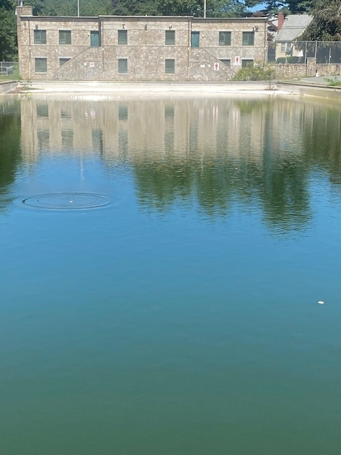
Budlong
Pool
Report
Mayor Ken Hopkins
9/6/2023

Slide 2
Thank you to the City Council.
Thank you to the residents.
Thank you to everyone who has voiced an opinion about what to do with the Budlong pool.
There has been much debate about whether we should save a recreational facility that was built by the WPA (Works Project Administration) during the Presidency of Franklin Delano Roosevelt (1939) or build a new facility that will let us move forward for generations to come.

Slide 3
There has been much debate in our community about this topic.
I think we can do better if we can answer one simple question: What is in the best interest of the 83,000 residents of our great city?
Many have voiced their opinions in open forums, extremely critical of my administration.
Tonight, I have the opportunity to present the facts and information, not for political posturing, but to answer the question as to why we should attempt another band aid approach.
I was voted into office and handed the task of making some very difficult decisions. I stand by my campaign slogan, “a name you can trust.” I have done my homework. I have listened to the people and the professionals.

Slide 4
Some people have questioned my leadership skills. Some said that I lie. Some say I don’t listen and do whatever I want. Personal attacks have not fazed me. They have only made me stronger in my attempt at getting to the truth.

Slide 5
Sensible use of the ARPA funds
Thoughts we should be addressing
We have the ARPA funds now.
Do we use Millions of dollars to make a temporary fix?
Is this prudent spending of taxpayer money based upon the past history of the pool?
We have one shot of getting this right.
Do we build a new facility that will last for the next 50 years?

Slide 6
Timeline of Pool History
1939-present
*Built in 1939 by the WPA under the Roosevelt Administration
*1960’s pool updated
*1973’s pool updated-Sal Saccoccio Architect
*2017-Request was made to waive formal bidding document
*Reason for the bid waiver: Mr. Liberatore said “We install heavy duty liner in Budlong Pool to save the city hundreds of thousands dollars in cost for cement, power washing and paint. This will eliminate that for years to come.”
January 2018- Purchase order was given to The Liner Shop for $197,000.

Slide 7
5/12/2021-meeting with Recreation Director Ray Tessaglia to discuss the Budlong Pool* still in the height of COVID
This estimate does not include work to motors, pump house, filtration system or the building
This meeting was the first in trying to open the pool.
6/14 Estimate from New England Aquatics to service the pool-$89,620.
This estimate is with the understanding that everything is in working order

Slide 8
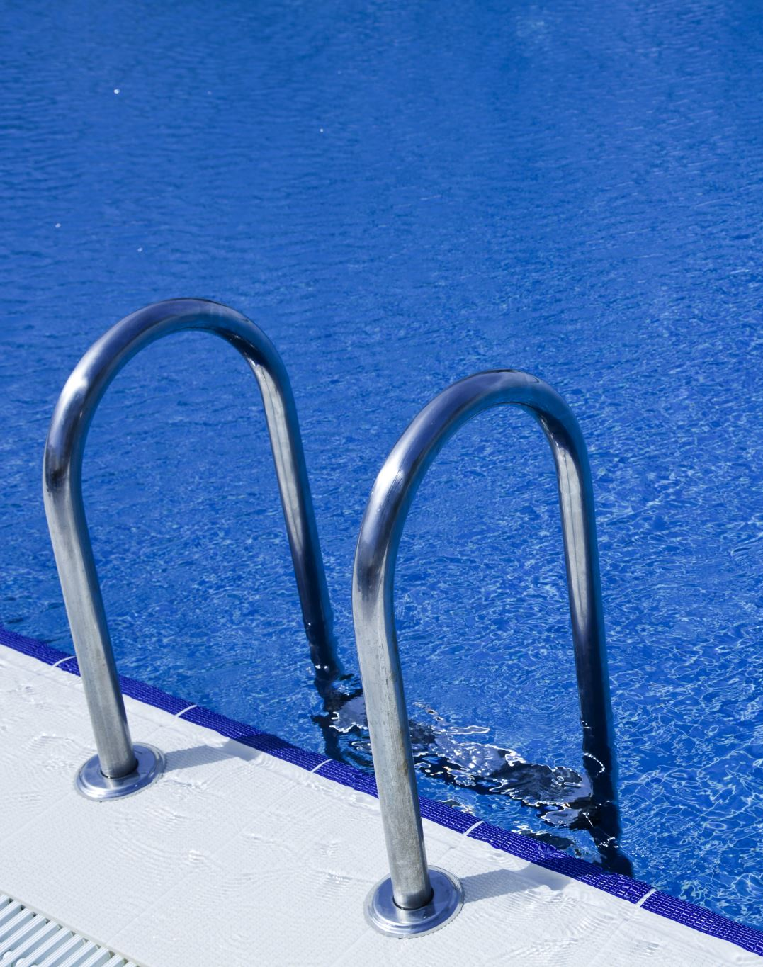
September 12, 2022
Letter from Saccoccio and Associates
A conceptual design of a pool is discussed
Estimated cost not to exceed $7,500.

Slide 9
Meeting in my office with Councilwoman Germaine
8/4/2022
“I love your vision. We are thinking alike. Thank you Mayor.”
This meeting was to get her feelings about building a new pool.
She looked at the first conceptual drawing and was very receptive.

Slide 10
POOL SIZE COMPARISONS
Budlong Pool
260’ X 85’
2’ to10’ depth
Nearly 1 million gallons of H2O
Holds approx. 1,250 people
Olympic pool
164’ x 82’
6’ deep
660,250 gallons of H2O
Holds approx. 440 people

Slide 11
Proposed size of a new pool/splash pad - “this will service over 500 people at one time.”
7,000 square feet
Big enough to accommodate approximately 500 people based upon state law of 15 feet per person
A splash pad could be built in the future to accommodate up to 50 children.

Slide 12
Budlong Pool Discussed in Public Meetings
Transparency - Council meeting timelines to discuss pool concerns
City Council
Jun ‘21 | Oct ‘21 | Nov ‘21 | May ‘22 | Sep ‘22 | Oct ‘22 | Dec ‘22 | Jan ‘23 | Feb ‘23 | Mar ‘23 | Apr ‘23 | May ‘23 | Jun ‘23 | Jul ‘23 | Aug ‘23
PW Cmte
Since June 2021, there have been 18 public meetings where the Budlong Pool has been discussed.

Slide 13
National COVID Pandemic
Budlong Pool Closed 2020, 2021
It remained closed for 2022 and 2023
Previous closures
It was previously closed in the summers of 2009 and 2010 due to financial constraints and needed repairs including replacement of the motor and pump for the filtration system.
Mid 1950’s due to a polio outbreak
1996 closed when the city could not pay for $400,000. in needed repairs and renovations

Slide 14
July 13, 2023
Meeting in my office with Karen Rosenberg and Susan Blake
THE MEETING WAS CORDIAL
Opportunity to listen to their concerns after reading remarks in the local newspaper attributed to Ms. Rosenberg
It ended after I answered all of their concerns.

Slide 15
Day # of season

Slide 16
Day # of season

Slide 17
Day # of season

Slide 18
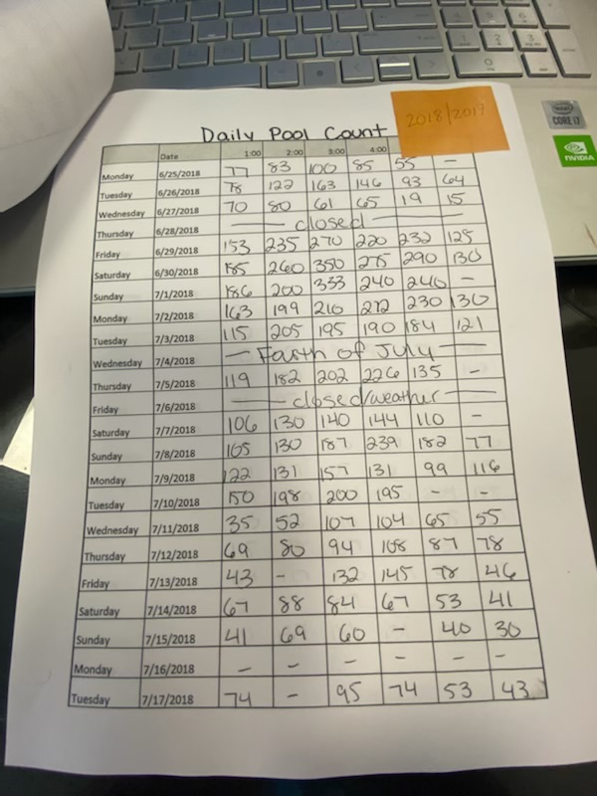
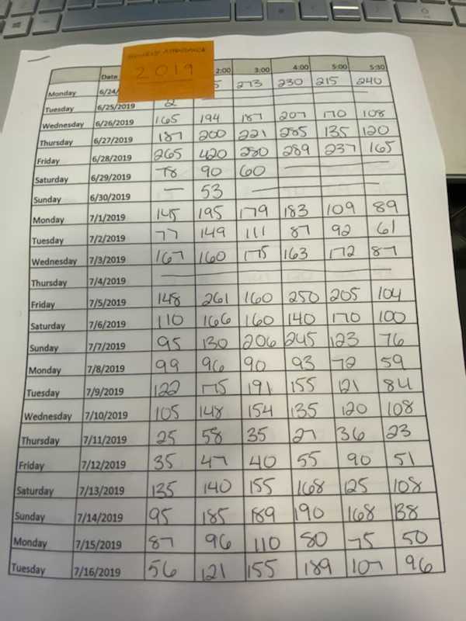
AVERAGE DAILY POOL ATTENDANCE FOR THE LAST THREE YEARS OF SERVICE
2017
2018
2019
3 Year Avg
122 per day
154 per day
142 per day
140 per day

Slide 19
Peak Hour Attendance Avg
Highest Hour Attendance Per Year

Slide 20
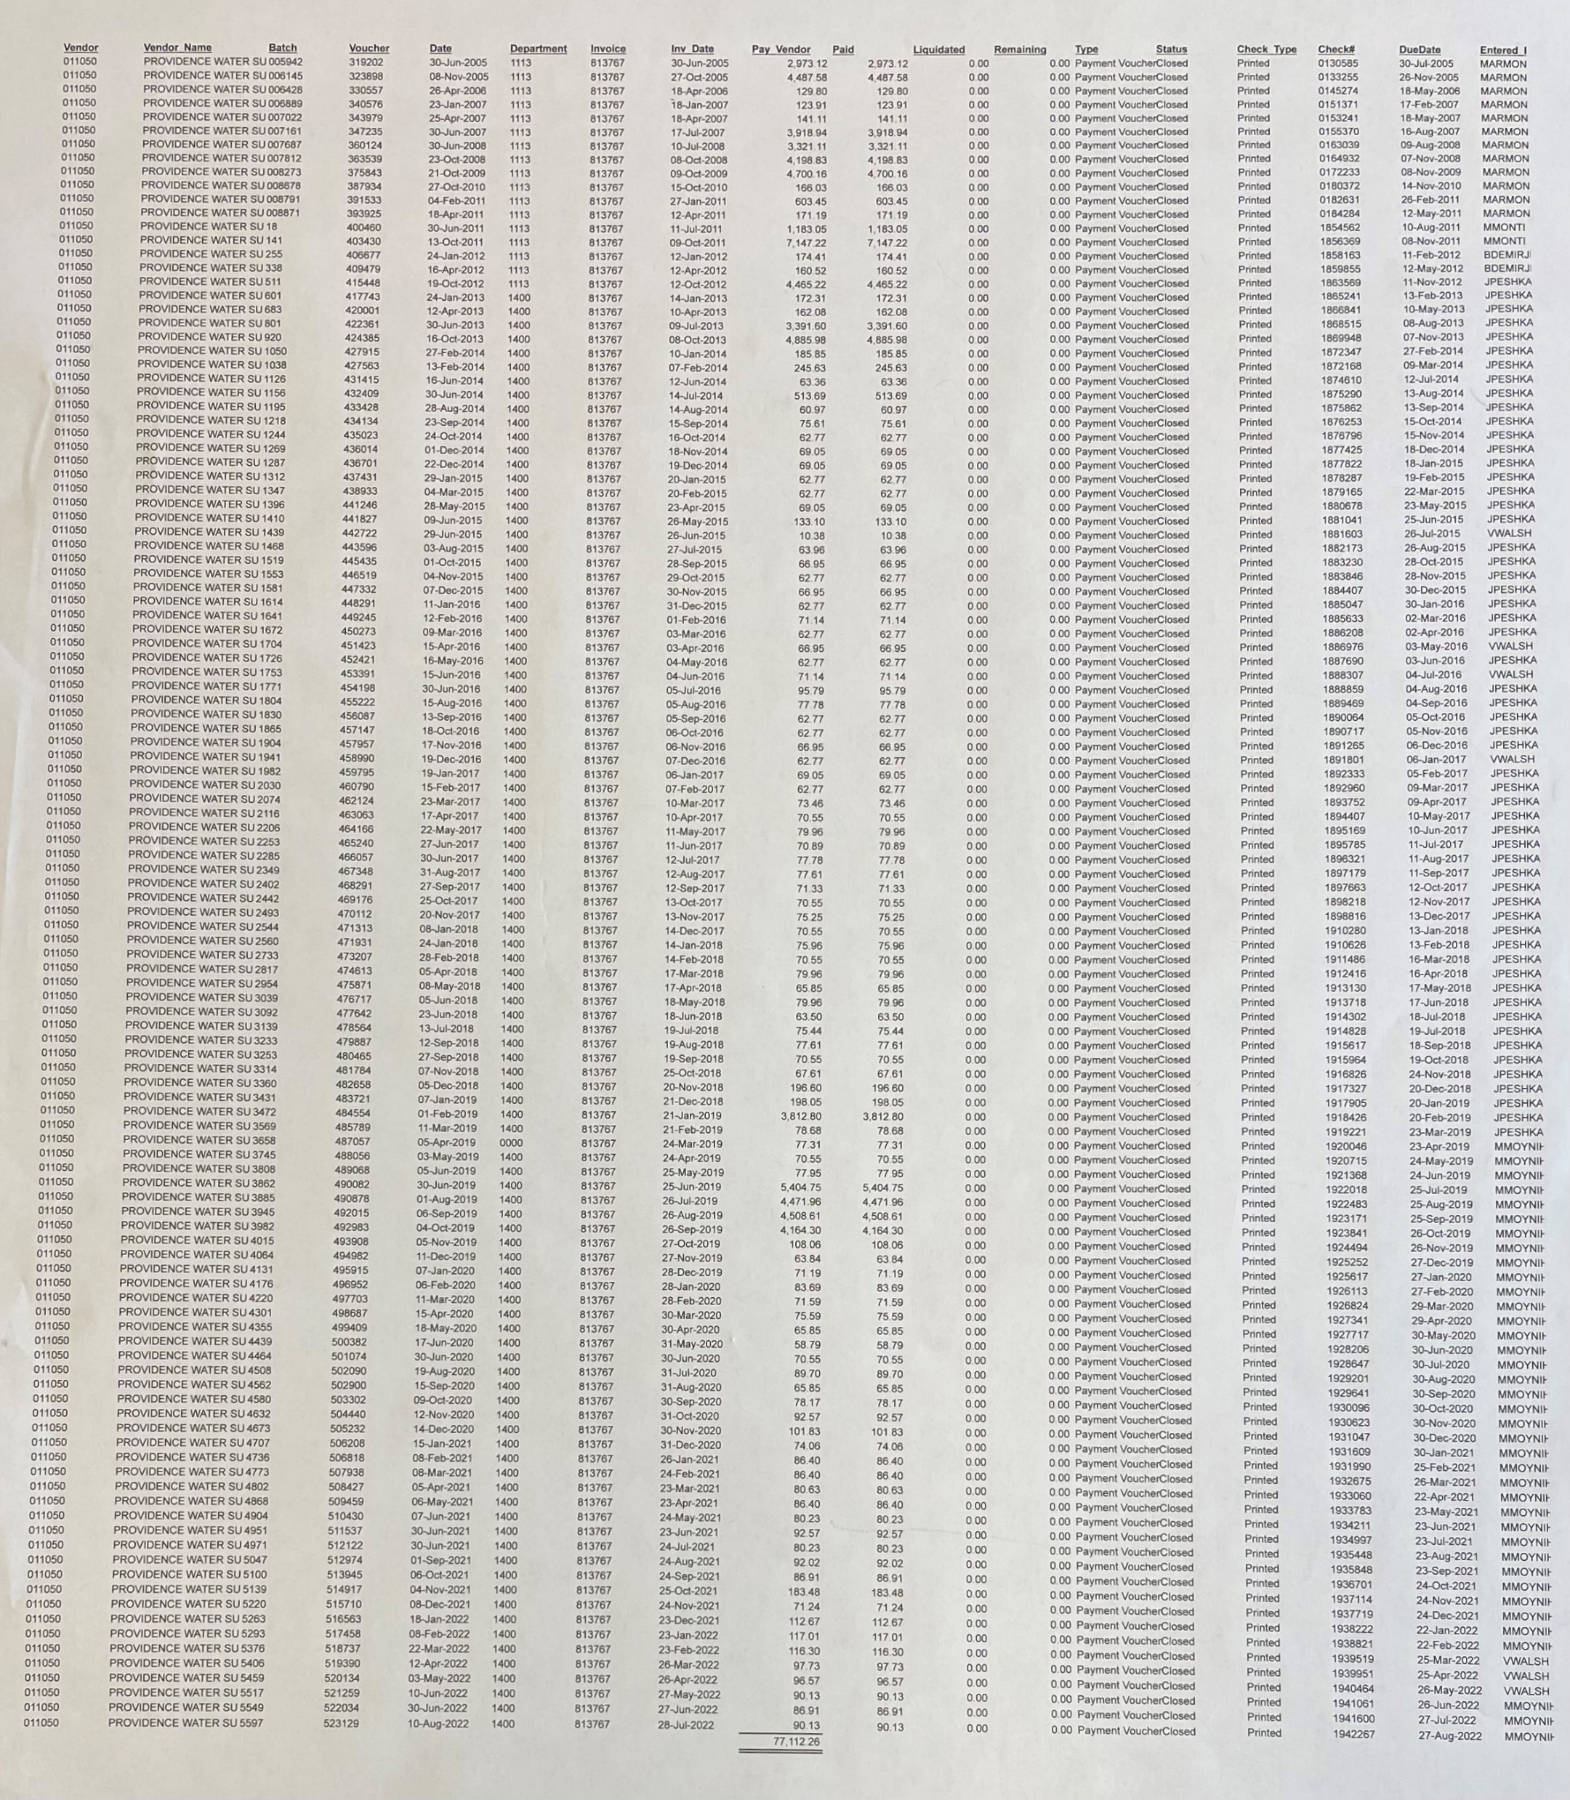
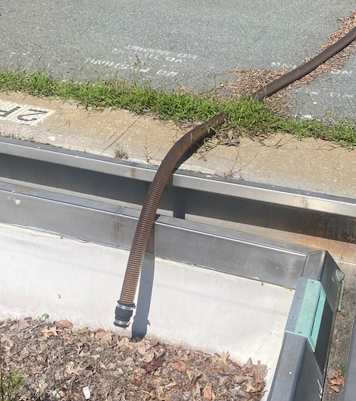
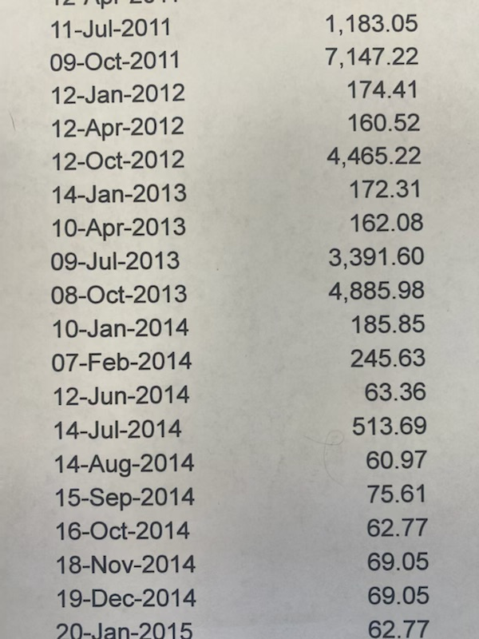
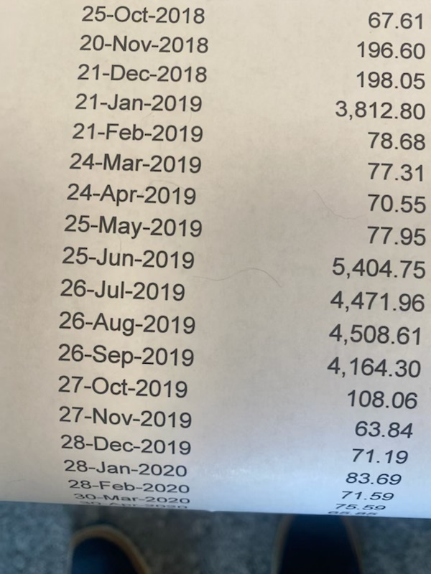
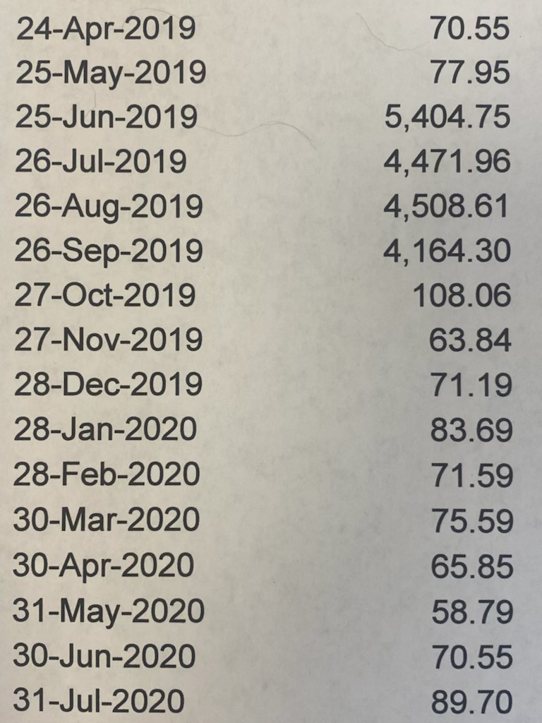
ARE THERE CRACKS IN THE FOUNDATION?
WATER BILLS…
Why are they so high?

Slide 21
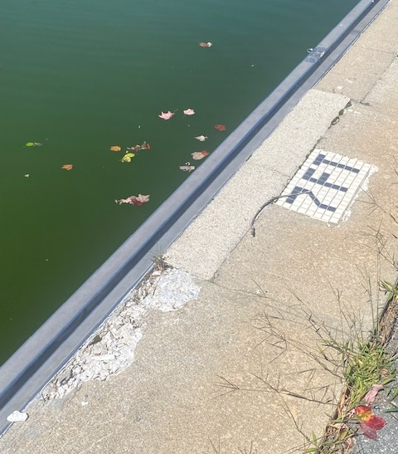
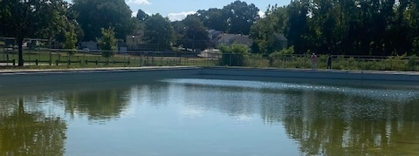
Current Pool Conditions

Slide 22
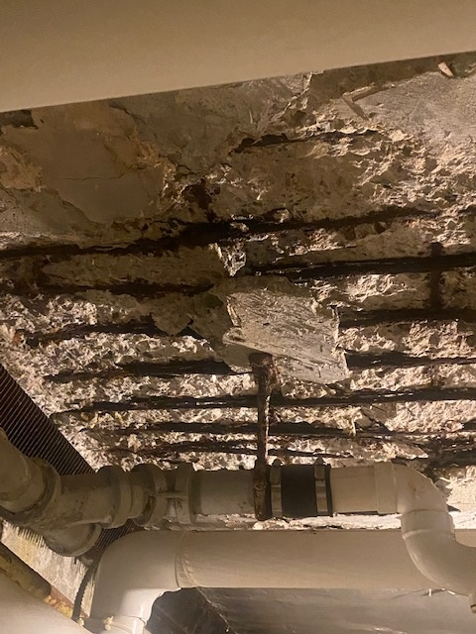
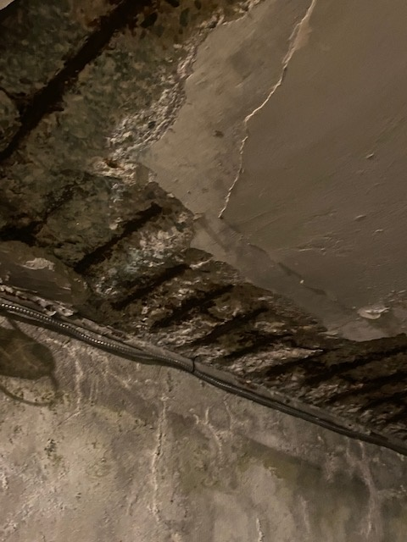
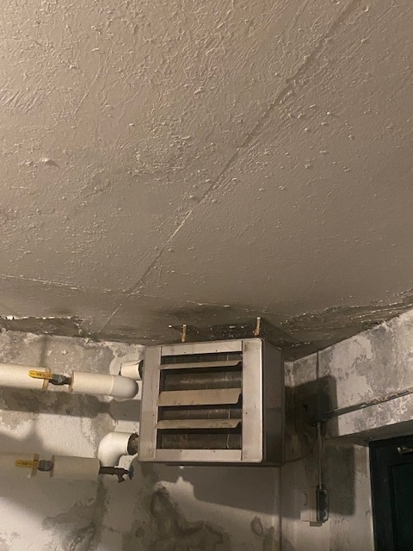
Current Pool Conditions

Slide 23
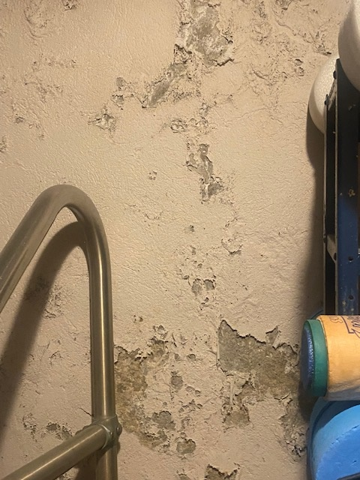
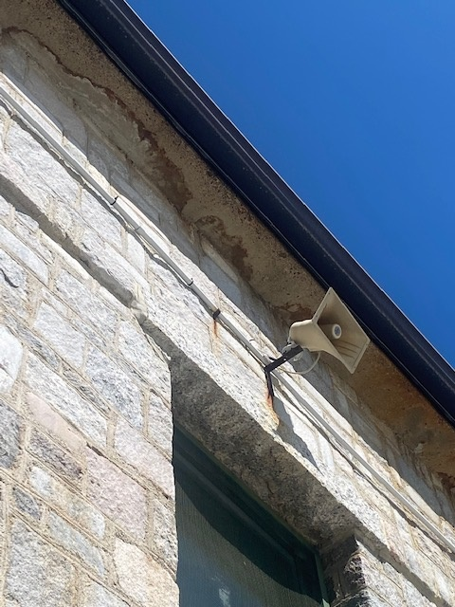
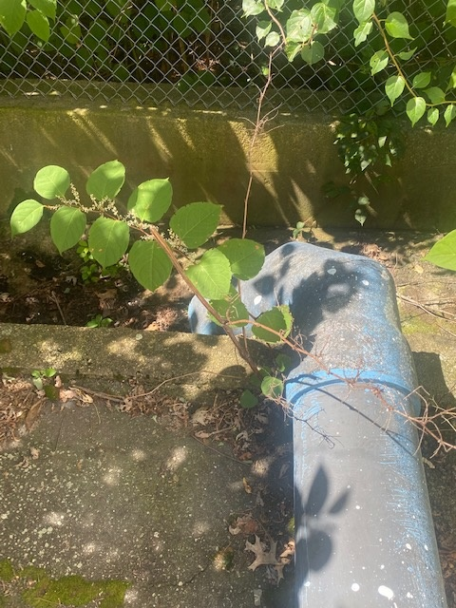
Current Pool Conditions

Slide 24
Concerns raised by the Public
“yes, I listened”
Initial proposal
Latest proposal
Depth of the pool
No Swimming lanes
Size of the pool
Historical nature
Memories
6 foot depth
3 Lap lanes added
7,000 square foot pool
WHY Modernize?
Aquatic trends in other communities
Last decades into the future
New memories for next generations

Slide 25
Professional references
The Pool Source
The Liner Shop
New England Aquatics
The Federal Hill Group LLC
Mr. Barry Fontaine
Weston and Sampson
Saccoccio and Associates
My conclusions are based upon the evidence and research presented by these professionals.

